Slide 1

CLINIC MANAGEMENT
SYSTEM
SUPERVISORS
DR. MOHAMED ELSAYEH
DR. HABIBA MOHAMED
MADE BY
MAHMOUD MOHAMED
241002523

Slide 2

Introduction
Steps of planning out how to start the work
The conceptual design identifies the primary entities and their relationships within the clinic ecosystem. Entities include Departments, Clinics, Doctors, Patients, and Appointments.
Then Relational Schema to assign the Foreign Keys
Then ER diagram to plan out the attributes
Then testing
Answering the required questions

Slide 3
Conceptual Design
The conceptual design identifies the primary entities and their relationships
Entities include Departments, Clinics, Doctors, Patients, and Appointments.
Department: Represents medical divisions such as Cardiology or Neurology.
Clinic: Locations where patients receive treatment, linked to departments.
Doctor: Medical professionals assigned to specific departments.
Patient: Individuals seeking medical services, with records of their demographics and jobs.
Appointment: The central transaction linking patients, doctors, and clinics, including dates, costs, and diagnosis.

Slide 4
Conceptual Design
The conceptual design identifies the primary entities and their relationships
Assigning Attributes for Each Entity
Department: DepartmentID, Name
Clinic: ClinicID, Name, Address
Doctor: DoctorID, Name, PhoneNumber, Address
Patient: PatientID, Name, PhoneNumber, Address, BirthDate, Job
Appointment: AppointmentID, Date, StartTime, EndTime, Cost, Status, Diagnosis

Slide 5
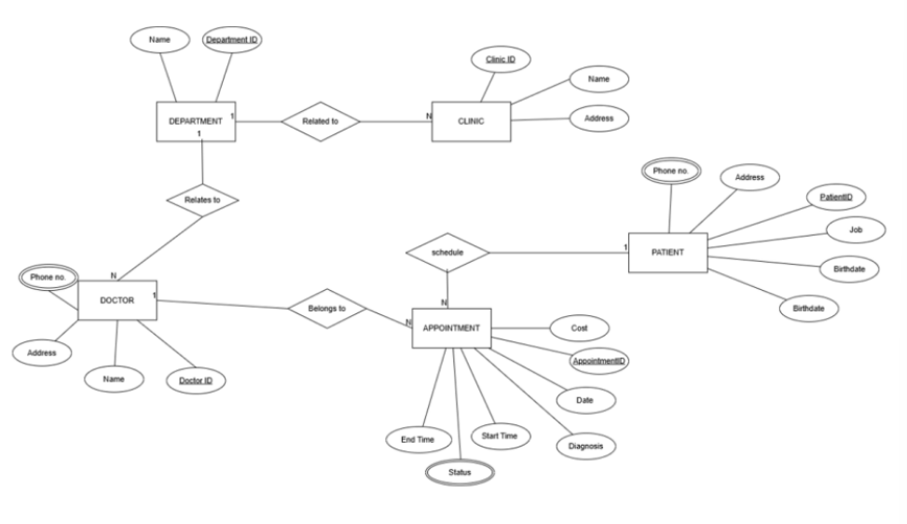
Conceptual Design

Slide 6
Relational Schema
To get ready for the ER Diagram and assigning the PK and FK
Department: DepartmentID (PK), Name
Clinic: ClinicID (PK), Name, Address, DepartmentID (FK)
Doctor: DoctorID (PK), Name, PhoneNumber, Address, DepartmentID (FK)
Patient: PatientID(PK), Name, PhoneNumber, Address, BirthDate, Job
Appointment: AppointmentID (PK), Date, StartTime, EndTime, Cost, Status, Diagnosis, PatientID (FK), DoctorID (FK)

Slide 7
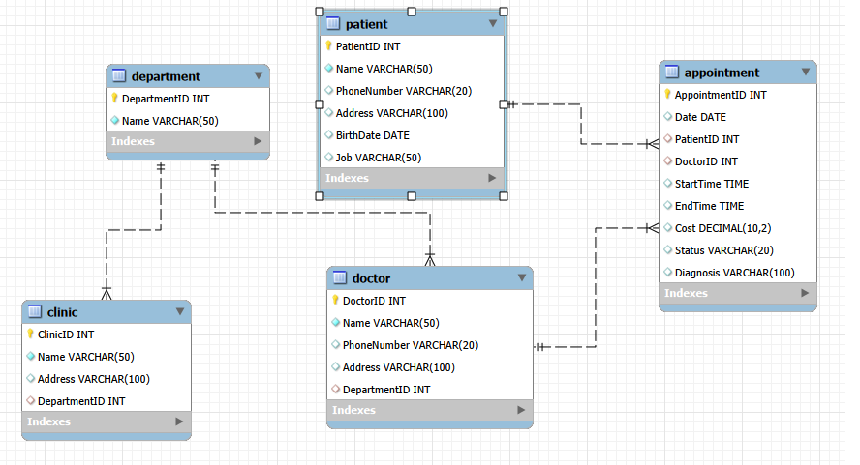
ER Diagram
The ER Diagram illustrates the main relationships and constraints in the Clinic Management System.
Cardinality Ratios: Department to Clinic (1:N), Doctor to Appointment (1:N), and Patient to Appointment (1:N).

Slide 8
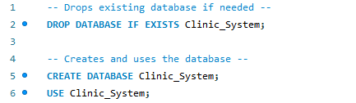
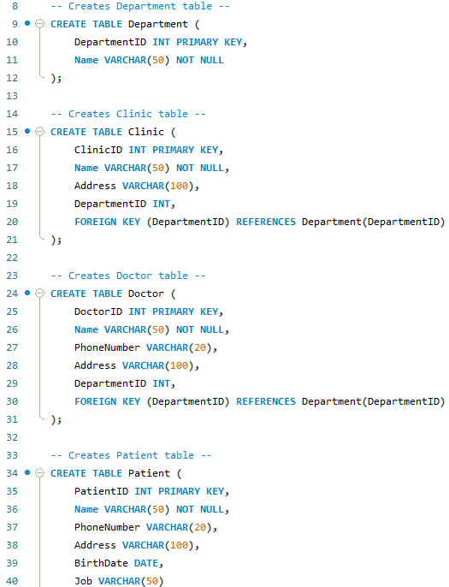
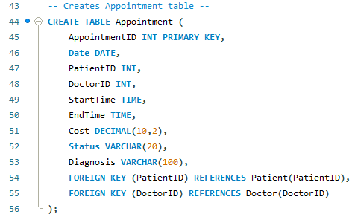
Testing

Slide 9
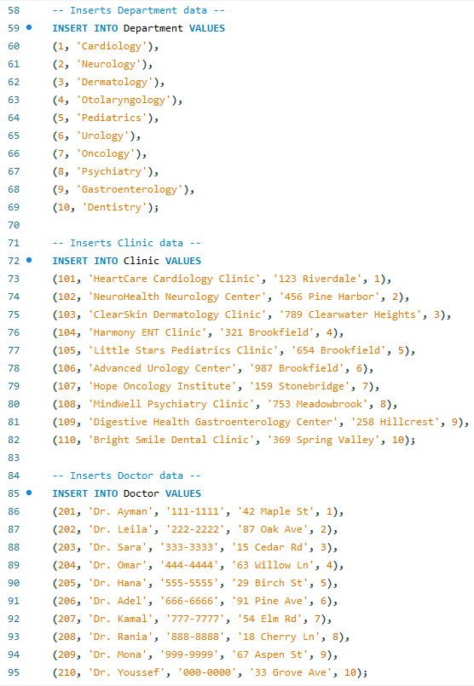
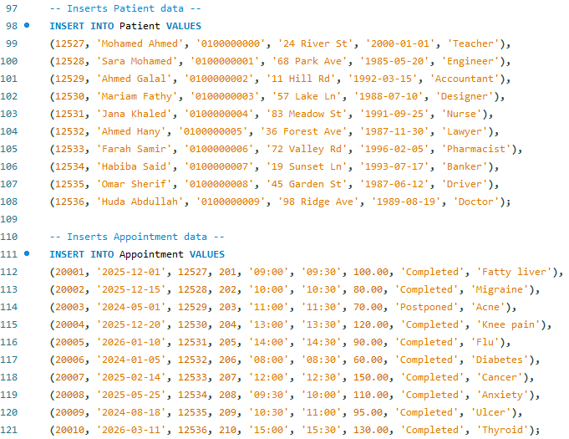
Testing

Slide 10
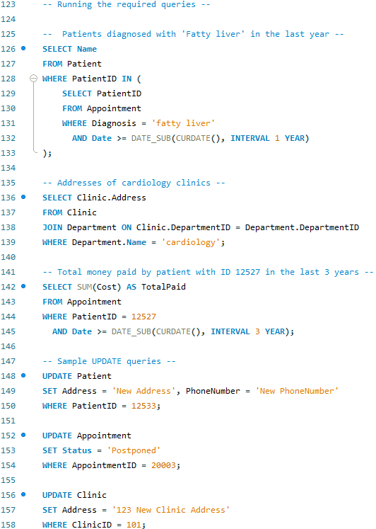
Testing

Slide 11
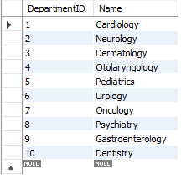
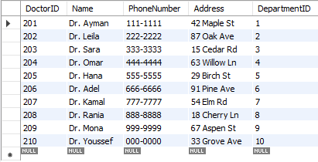
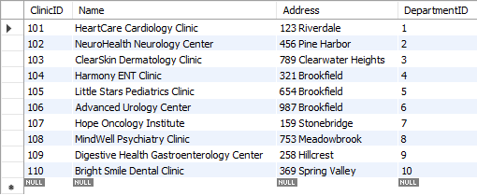
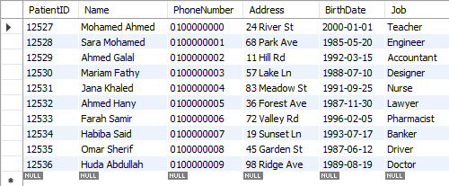
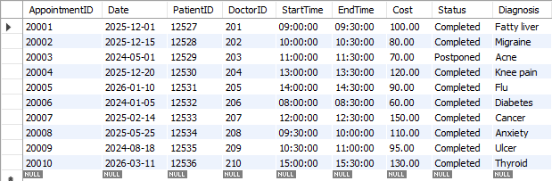
Results

Slide 12
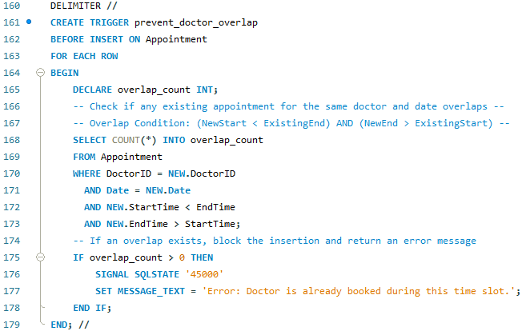
Questions
Question 1: How would you prevent two appointments for the same doctor from overlapping?

Slide 13
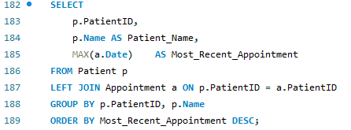
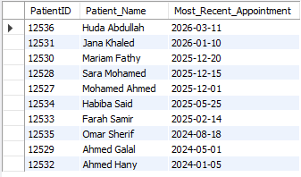
Questions
Question 2: Describe a query to fetch each patient's name plus their most recent appointment date
This requires a left join between Patient and Appointment so that patients that have no appointments are still included. Then max(a.Date) finds the latest appointment, and group by the patient's ID and name to combine multiple rows into one per patient.

Slide 14
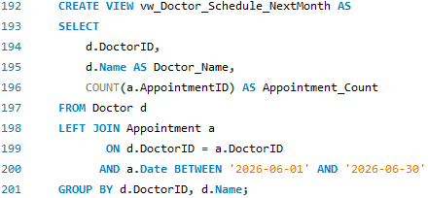
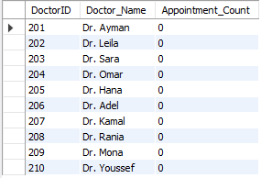
Questions
Question 3: A view showing each doctor's upcoming appointment count for next month. What would its GROUP BY look like?

Slide 15
THANK YOU!

